Slide 1
.NET Core Workshop
Mariano Sánchez
sanchezmariano@outlook.com @marianosz
http://weblogs.asp.net/marianos

Slide 2
Dependency Injection (DI)

Slide 3
Dependency Injection (DI)
Classes request dependencies instead of referencing directly
Dependent object instances are injected as parameters (or properties)
Allows for flexibility and modularity
Classes follow Explicit Dependencies Principle, Dependency Inversion Principle

Slide 4
Explicit Dependencies Principle
Classes should express their requirements through their constructor
Direct use of specific collaborators creates hidden dependencies
Classes with hidden dependencies aren’t “honest” about what they require
Constructor should be a contract that specifies what the class requires

Slide 5
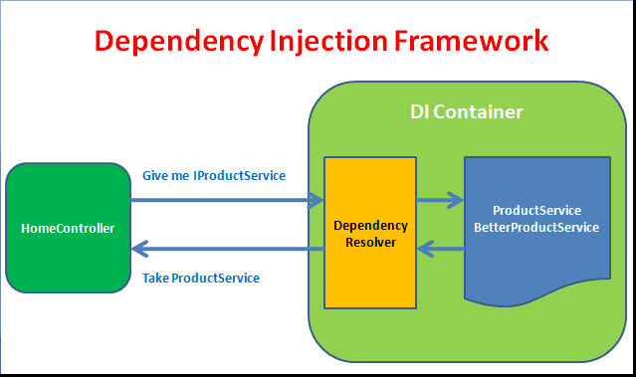
Dependency Injection on .NET Core

Slide 6
Startup ConfigureServices
Add framework services needed by app to services collection
Add application services to services collection
Optional
Configure Options used by app components
Configure third-party container
StructureMap, Unity, Autofac, Ninject, Castle Windsor, etc.

Slide 7
Data Access

Slide 8


Data Access
.NET Core offers providers for Data Access on different platforms:
SQL Server / Azure SQL Database
PostgreSQL
SQLite
MySQL
Oracle
No changes to the data access code
ADO.NET
Entity Framework
No data migration needed
Azure SQL Database
SQL Server
In cloud
On premise

Slide 9

Working With a Database Using EF Core
Add Entity Framework Core (EF Core) in ConfigureServices:
Also supports InMemory – Install this package:
and modify ConfigureServices:
services.AddDbContext<AppDbContext>(options =>
options.UseInMemoryDatabase(“DbName”));
//options.UseSqlServer(Configuration.GetConnectionString("DefaultConnection")));

Slide 10
Deploy

Slide 11
Deploy
Xcopy deployment
On-premises
Azure - Windows or Linux VMs
Docker container
Windows container
You can use any of the deployment technology available on the corresponding OS (Windows / Linux / OS X)
.NET Core travels with the app
A machine-level .NET installation is not required, only the runtime.

Slide 12
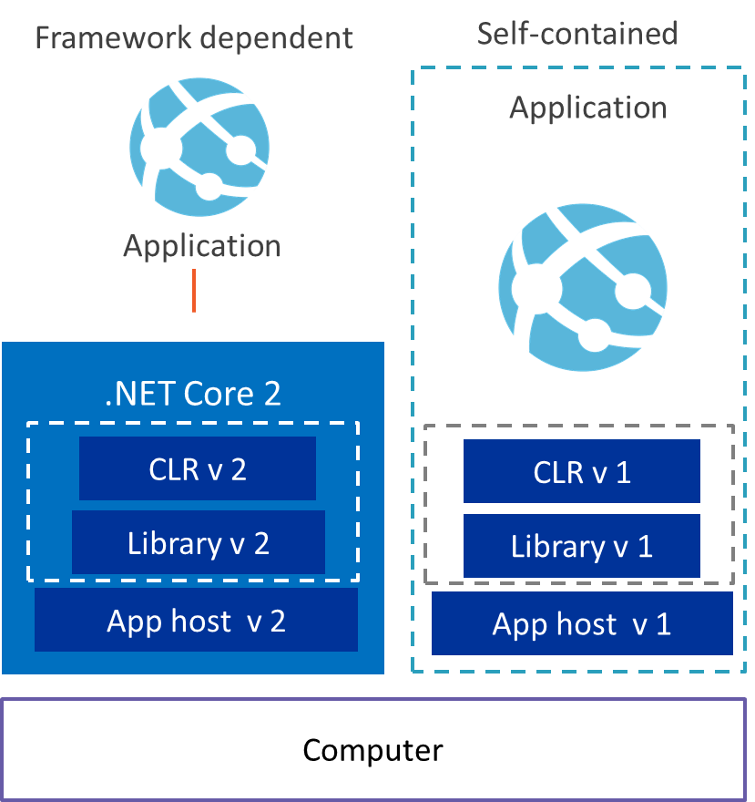
.NET Core application deployment options

Slide 13
.NET Core application deployment options
Framework-dependent applications require the .NET Core framework to be installed on the machine that the app will run on.
Self-contained applications don’t, because they contain everything the app needs to run
Framework-dependent applications can run on any operating system that you install .NET Core on, without modification
In contrast, for every OS that you want a self-contained app to run on, you need to publish an OS-specific version

Slide 14
Going to Production
Host my app
dotnet run?
Request
Multiple Apps on one Server?
(only one port 80)
Kestrel
My Web App
And SSL?
Response
Windows authentication?

Slide 15
Going to Production
Run it with a
reverse proxy
:80/:443
:5000
IIS – nginx – apache
IIS
Kestrel
Install ASP.NET Core Module first
My Web App
nginx
Apache

Slide 16
.NET Fragmentation
.NET FRAMEWORK
.NET CORE
XAMARIN
APP
MODELS
WPF
Windows Forms
UWP
iOS
Android
ASP.NET
ASP.NET Core
OS X
BASE
LIBRARIES
Base Class Library
Core Library
Mono Class Library
COMMON INFRASTRUCTURE
Compilers
Languages
Runtime components
Notes:
Notes: Even if we are reusing a lot across components (especially with the open sourcing last year), the reality is that each platform has its own implementation of the base libraries.
Note: .NET Framework BCL and Mono BCL are the same APIs, different implementation. .NET Core “Core Library” is a similar set of APIs, but different.

Slide 17
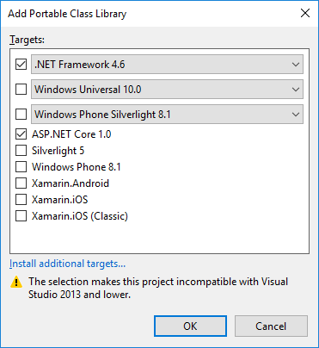

Code Sharing – Portable Class Library
.NET Framework
Windows Universal
Windows Phone

Slide 18
.NET yesterday—app models and libraries
.NET FRAMEWORK
.NET CORE
XAMARIN
APP
MODELS
WPF
Windows Forms
UWP
iOS
Android
ASP.NET
ASP.NET Core
OS X
BASE
LIBRARIES
Base Class Library
Core Library
Mono Class Library
COMMON INFRASTRUCTURE
Compilers
Languages
Runtime components
Notes:
Notes: Even if we are reusing a lot across components (especially with the open sourcing last year), the reality is that each platform has its own implementation of the base libraries.
Note: .NET Framework BCL and Mono BCL are the same APIs, different implementation. .NET Core “Core Library” is a similar set of APIs, but different.

Slide 19
.NET yesterday—reusing code
CHALLENGES
Difficult to reuse skills
Need to master 3+1 base class libraries
Difficult to reuse code
Need to target a small common denominator
Difficult to innovate
Need implementations on each platform
Implementation 3
Implementation 2
Implementation 1

Slide 20
.NET today
.NET FRAMEWORK
.NET CORE
XAMARIN
WPF
Windows Forms
UWP
iOS
Android
ASP.NET
ASP.NET Core
OS X
.NET STANDARD LIBRARY
One library to rule them all
COMMON INFRASTRUCTURE
Compilers
Languages
Runtime components
Notes:
Notes: Please welcome the .NET Standard Library [explain details]
As we move into the future we want to make it much easier for .NET developers to write their code once and be able to execute across .NET implementations, whether that’s .NET Framework, .NET Core, or Mono/Xamarin. To this end, we will continue to evolve and expand the .NET Standard into a set of APIs that are shared broadly across frameworks and application models. This will provide our ecosystem with much more explosive growth with libraries that can shared much more easily.

Slide 21
.NET Standard
.NET Standard is a specification that represents a set of APIs that all .NET platforms have to implement.
This unifies the .NET platforms and prevents future fragmentation.

Slide 22
.NET Standard library
One library to rule them all
Learn one API across ALL .NET platforms
Reuse your code across ALL .NET platforms
Easily consume third-party/OSS libraries across ALL .NET platforms
.NET Standard 1.x
Evolution of Portable Class Libraries (PCLs) with a much simpler model
Two constraints:
API surface relatively small, because .NET Core was small
Can’t reference the vast number of libraries already available for .NET Framework

Slide 23
.NET Standard 2.0
Has much bigger API surface
Extended to cover intersection between .NET Framework and Xamarin
Also makes .NET Core 2.0 bigger as it implements .NET Standard 2.0
+20K
More APIs than
.NET Standard 1.x
Can reference .NET Framework libraries
Compatibility shim allows referencing existing .NET Framework binaries
No recompile required – also covers existing NuGet packages
Limited to libraries that only use APIs that are available for .NET Standard
~70%
of NuGet packages
are API compatible

Slide 24
.NET today—reusing code
BENEFITS
Reuse skills
Master one library, not a platform
Reuse code
Big surface area - no small common denominator
Faster innovation
.NET Standard can grow without updating platforms
Reference implementations
Full implementations
Notes:
Notes: Reusing code is dramatically better with the .NET Standard Library. It includes reference implementations, just like the PCL but it also can be extended with full implementations shared across all platforms.

Slide 25


.NET Standard
WINDOWS
DESKTOP
CLOUD MICROSERVICES
WINDOWS UWP
IOS, ANDROID
GAMES/ 3D
Visual Studio
.NET STANDARD
Visual Studio for Mac
INFRASTRUCTURE
COMPILERS
LANGUAGES
RUNTIME COMPONENTS
Visual Studio Code
.NET Standard allows sharing code, binaries, and skills between .NET client, server, and all flavors
.NET Standard provides a specification for any platform to implement
All .NET runtimes provided by Microsoft implement the standard

Slide 26
Nothing changes
MY
.NET FRAMEWORK
APP
MY
.NET CORE
APP
MY
XAMARIN
APP
MY STANDARD LIBRARY
EXISTING
.NET STANDARD LIBRARY
EXISTING
PORTABLE CLASS LIBRARY
EXISTING
.NET FRAMEWORK LIBRARY

Slide 27
How does .NET Standard work?
.NET Standard is represented by:
The NuGet package NetStandard.Library which contains the reference assembly netstandard.dll
At build time
.NET Standard bridges references to existing .NET Framework and PCL assemblies via type forwarding
At runtime
Each platform provides an implementation for netstandard.dll that type forwards to its implementation

Slide 28
How is .NET Standard different from .NET Core?
.NET Standard is a specification that covers which APIs a .NET platform has to implement.
.NET Core is a concrete .NET platform and implements the .NET Standard.

Slide 29
.NET today
.NET FRAMEWORK
.NET CORE
XAMARIN
WPF
Windows Forms
UWP
iOS
Android
ASP.NET
ASP.NET Core
OS X
.NET STANDARD LIBRARY
One library to rule them all
COMMON INFRASTRUCTURE
Compilers
Languages
Runtime components
Notes:
Notes: Please welcome the .NET Standard Library [explain details]
As we move into the future we want to make it much easier for .NET developers to write their code once and be able to execute across .NET implementations, whether that’s .NET Framework, .NET Core, or Mono/Xamarin. To this end, we will continue to evolve and expand the .NET Standard into a set of APIs that are shared broadly across frameworks and application models. This will provide our ecosystem with much more explosive growth with libraries that can shared much more easily.

Slide 30
APIs in .NET Standard 2.0
XML
XLinq • XML Document • XPath • Schema • XSL
SERIALIZATION
BinaryFormatter • Data Contract • XML
NETWORKING
Sockets • HTTP • Mail • WebSockets
IO
Files • Compression • MMF
THREADING
Threads • Thread Pool • Tasks
CORE
Primitives • Collections • Reflection • Interop • Linq

Slide 31
Demo: .NET Standard

Slide 32
¿Preguntas?

Slide 33
¡ Gracias!
Mariano Sánchez
sanchezmariano@outlook.com @marianosz
http://weblogs.asp.net/marianos

